Slide 1

P1 Presentation
Joshua Sevilla
Github link: https://github.com/Will-BigData/Joshua-Sevilla-P1.git

Slide 2
Project Details
Create a store application with user and admin roles.
Users can make purchases and view a history of their orders.
Users can edit their own account and login information.
Admins can view all users, view all logins, view all transactions, and perform CRUD operations on all users, logins, transactions, and products.

Slide 3
Tech Stack
Python 3
MongoDB
Git

Slide 4

P1 – A Client-Side Grocery Store
A simple store where users can login and purchase any available items and view a history of the transactions they made.
Admins are responsible for monitoring the users and transactions made in the store as well as adding new products and restocking old products.
Users can search for products in the store by name.
Users can search transactions they made on a given day.

Slide 5
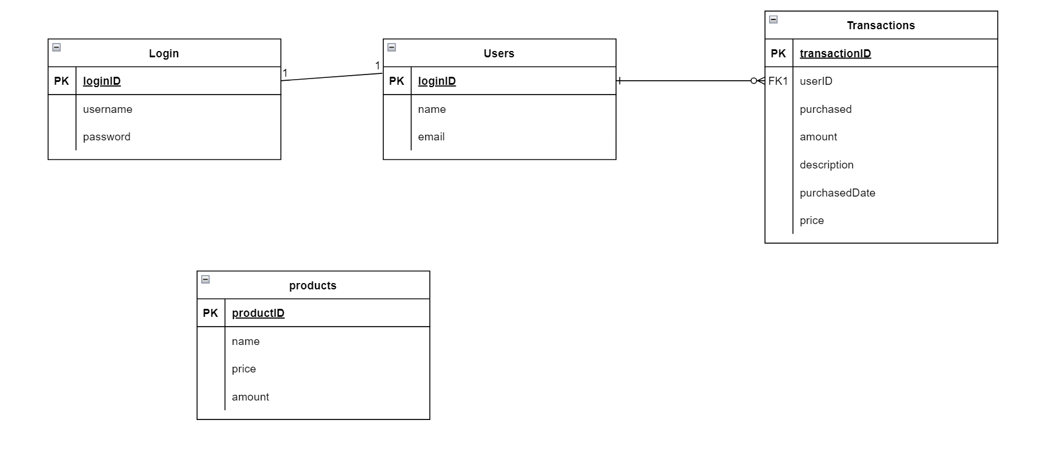
ERD

Slide 6
Demo

